Slide 1



Amser
Time

Slide 2

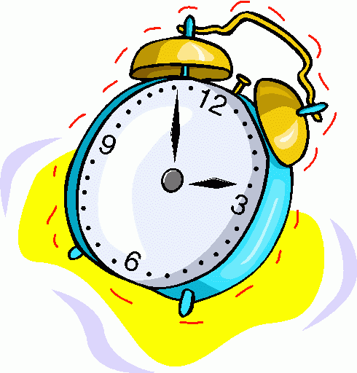
6.45 am

Slide 3
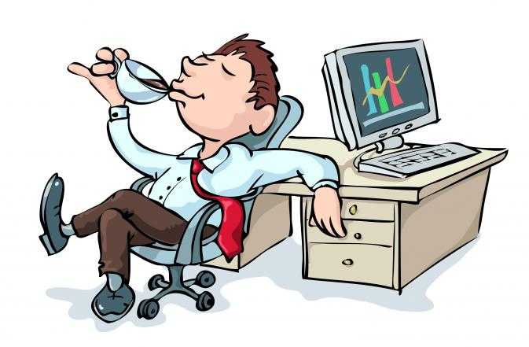
10.30 am

Slide 4
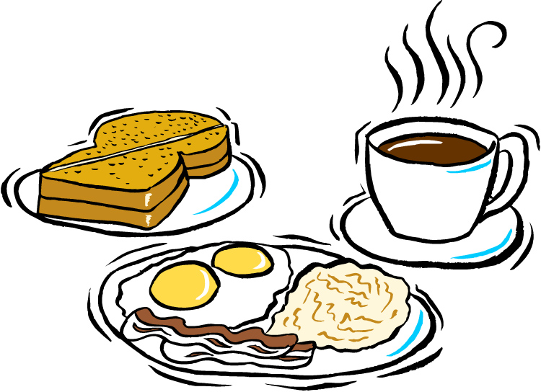
8.20 am

Slide 5

1.00 pm

Slide 6

2.15 pm

Slide 7
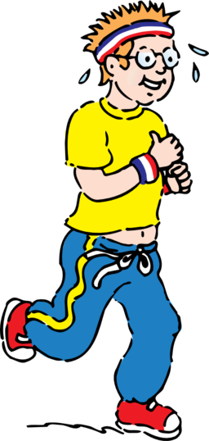
4.20 pm

Slide 8

4.55 pm

Slide 9
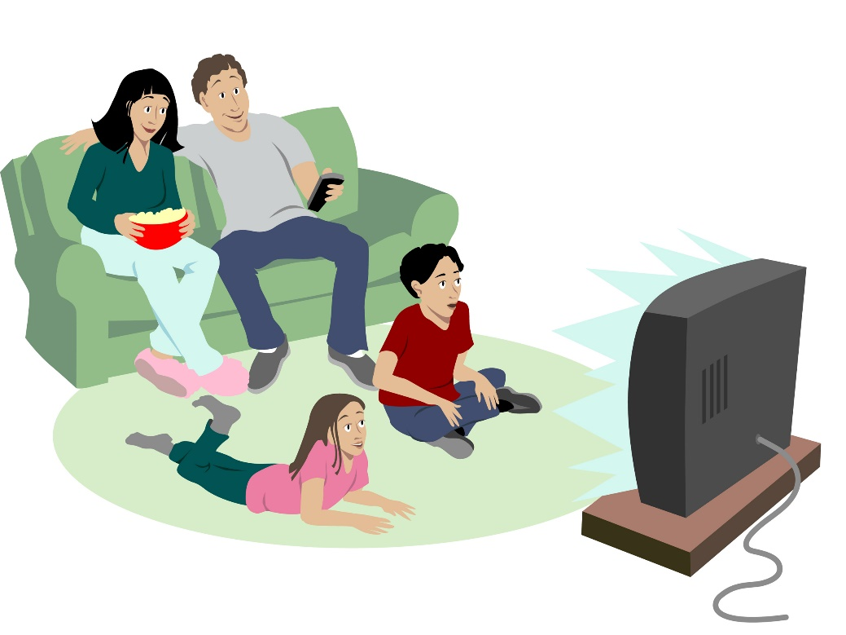
7. 00 pm

Slide 10
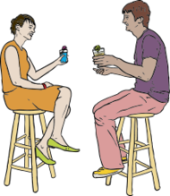
9. 00 pm

Slide 11
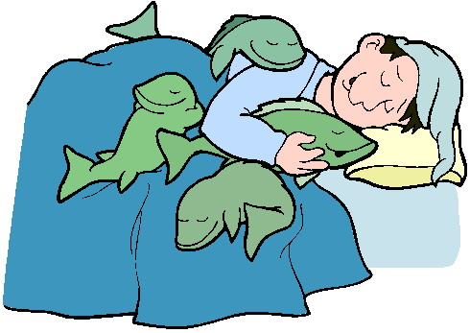
11.25 pm

Slide 12



Sut dach chi?
Hapus?
Trist?
Cwestiynau?

